Slide 1

How is digital technology transforming our economy in India?
BY KTC HUBLI
Group 4:
Harish H K
Supriya M K
Gourav P
Kiran
Sanjay
GUIDED BY
MOHAMMAD TAHIR MIRJI
L2 KTC Hubli
Case Study For
Expert: Soumyajit Dey

Slide 2
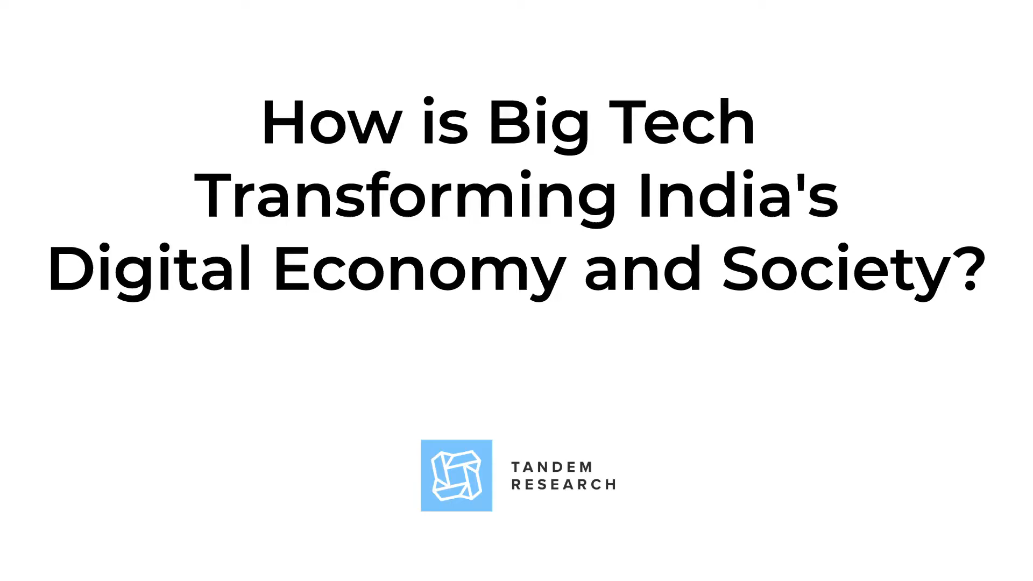
digital technology transforming our economy

Slide 3
While digital technology is transforming the Indian economy in many positive ways,
Infrastructure challenges:
Skill gaps
Cybersecurity concerns:
Digital divide
Overall problem and business challenges

Slide 4
Infrastructure challenges: While there has been significant progress in the development of digital infrastructure in India, there are still challenges that need to be addressed, such as poor internet connectivity and power supply in some areas. This can limit the adoption of digital technology and hinder the growth of businesses in these areas.
Skill gaps: There is a significant skill gap in India when it comes to digital technology, with many workers lacking the skills and knowledge needed to work in the digital economy. This can limit the ability of businesses to leverage digital technology and compete in the global market.
Cybersecurity concerns: With the growth of digital technology, there are also concerns around cybersecurity and data privacy. Businesses need to take steps to ensure that their data and systems are secure and protect their customers' privacy to maintain their reputation and trust.
Digital divide: There is a significant digital divide in India, with many people in rural areas and low-income households lacking access to digital technology. This can limit their ability to participate in the digital economy and access the benefits of digital technology.
Overall problem and business challenges

Slide 5
Current status
The current status of how digital technology is transforming the Indian economy is quite positive India is undergoing a digital revolution, and digital technology is transforming the way businesses operate and how people interact with each other. Here are some examples of how digital technology is transforming the Indian economy:
E-commerce
Digital payments
Digital marketing
Remote work

Slide 6
Current status
E-commerce: E-commerce has become a significant contributor to the Indian economy, with more and more people shopping online. According to a report by the Indian Brand Equity Foundation.
Digital payments: Digital payments have become increasingly popular in India, with the government's push for a cashless economy and the rise of digital wallets such as Paytm and Google Pay.
Digital marketing: Digital marketing has become an essential tool for businesses in India to reach their target audience and increase sales. Social media platforms such as Facebook and Instagram have become powerful marketing tools for businesses.
Remote work: The COVID-19 pandemic has accelerated the trend towards remote work in India, with more and more companies adopting work-from-home policies. This has led to increased productivity, reduced costs, and improved work-life balance for employees.

Slide 7
How we will solve the problem
To solve the challenges and problems related to digital technology transforming the Indian economy, here are some potential solutions:
Bridging the digital divide:
Ensuring data privacy and security:
Promoting digital literacy:
Encouraging innovation:

Slide 8
How we will solve the problem
Bridging the digital divide: The government and businesses need to work together to bridge the digital divide by increasing access to digital infrastructure, such as high-speed internet and smartphones, in rural and underprivileged areas.
Ensuring data privacy and security: With the increased use of digital technology, it is crucial to ensure data privacy and security to protect users' personal information. The government needs to enact robust data protection laws and regulations to prevent data breaches and cyber-attacks.
Promoting digital literacy: To ensure that everyone benefits from the digital revolution, there needs to be a focus on promoting digital literacy and providing training and education programs to help people develop digital skills.
Encouraging innovation: The government needs to encourage innovation and entrepreneurship by creating a favorable environment for startups and small businesses. This could include policies such as tax incentives and easier access to funding.

Slide 9
What is the impact for business
The impact of digital technology on businesses in India has been significant. Here are some ways in which digital technology has transformed the Indian business landscape:
Increased efficiency
Enhanced customer engagement
Expanded reach
Improved decision-making

Slide 10
What is the impact for business
Increased efficiency: Digital technology has made businesses more efficient by streamlining processes and reducing manual labor. For example, automation of repetitive tasks, such as accounting and invoicing, has led to significant time savings for businesses.
Enhanced customer engagement: Digital technology has transformed the way businesses engage with customers by providing more personalized and interactive experiences. Social media platforms and messaging apps have become popular tools for businesses to communicate with customers and build relationships with them
Expanded reach: E-commerce and digital marketing have allowed businesses to expand their reach beyond their local markets to reach customers across the country or even globally. This has opened up new growth opportunities for businesses
.Improved decision-making: With the availability of big data and analytics tools, businesses can now make data-driven decisions. This has led to more informed and accurate decision-making, leading to improved business outcomes.

Slide 11
Business Model
Getting users to participate in competition to get prizes as free travel, and generating leads using the data collected

Slide 12
Conclusion
In conclusion, digital technology is transforming the Indian economy by creating new industries, improving financial inclusion, creating job opportunities, and improving the delivery of government services. However, there are still challenges to be addressed, such as ensuring equal access to technology and addressing cybersecurity risks. Overall, digital technology has the potential to significantly boost India's economic growth and development.

Slide 13


